Slide 1
Name: Modhale Snehal Ishwar
Farmo.in
Class : Master Of Computer Science
Level: PG

Slide 2
Farmo.in

Slide 3
Fields
Since, people do not know enough about availability of machinery, vehicle and workers in the area
Agricultural Machinery and Labour are not available on time
False promises of workers and vehicle owners cause huge losses to people/farmers
Customers have to spend more money than their actual estimate

Slide 4

Project analysis slide 2
What is Farmo.in?
Farmo.in is an online platform. With the help of this website and mobile application farmers can easily find the workers and machinery required for agriculture. It also helps in finding transportation vehicles and more, all at the right time and at the right price.

Slide 5
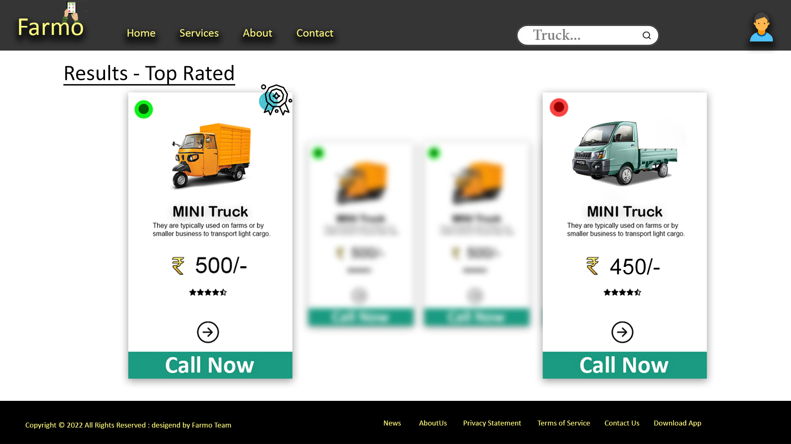

Slide 6
Project analysis slide 2
Key Features
1 . Workers 2. Agricultural Machinery 3. Transportation Vehicles
Monitoring Price Action
Gives More Options
PROJECT
D2C
User Friendly UI
Available in Local Languages
Easy to Find

Slide 7
Project analysis slide 3
WorkFlow
Registration
Categorize
Direct C2C Business
Promoting
Free
Using Mobile Number and some Basic info like Name, Address,
Age, Price etc.
Put the Services into Different Groups.
No Middlemen Needed
Promoting Services
For a better experience or more revenue
Free to Use for service consumers

Slide 8
Project analysis slide 6
Project Analysis
36.1 Million Farmers
7.9 million micro, small& medium enterprises
18.6 million Unemployed
More Than 70-80 % of people depend on others.
Big Timing Issue mainly Rural Area’s

Slide 9
Thank You

